Slide 1
Association Rule Mining (ARM)
Presented By:
Charles Kibet Ng'etich
Edwin Seno
George Kihara Mburu
Marion Jeptoo
Geofrey Nyabuto
Joyadams Munene
Muriithi Alex Karani
John kimani Muragu
Nyairo Charles Magati
Date: 31/03/2026

Slide 2
What is Association Rule Mining (ARM)?
A data mining technique to find meaningful patterns, relationships, and associations among items.
Identifies co-occurrence relationships: Which items frequently appear together.
Example (Kenyan Supermarket): Customers buying ugali flour often also buy cooking oil.
Value: Optimize promotions, enhance shelf layouts, refine cross-promotion strategies.

Slide 3
How ARM Works: A Two-Step Process
Identify Frequent Itemsets:
Find groups of items that commonly appear together across many transactions.
Example: {ugali flour, cooking oil} appears frequently.
Generate Rules:
Create "If-Then" statements from frequent itemsets.
Example: "If a customer buys bread, then they are likely to buy butter."

Slide 4

Applications of ARM
Retail:
Product pairings (e.g., maize flour frequently bought with cooking oil).
Bundling products & optimizing store layouts.
Finance:
Detecting anomalies and fraud patterns in M-Pesa transaction logs.
Agriculture:
Analyzing purchase patterns of seeds, fertilizers, tools by cooperatives.
Example: Farmers buying maize seeds often purchase a specific fertilizer $⇒$ offer bundled discounts.

Slide 5
Key Metrics in ARM
To evaluate association rules, we use:
Support
Confidence
Lift

Slide 6

Metric 1: Support
Measures the frequency of an itemset's occurrence within the entire dataset.
Indicates how popular an item or itemset is.
$$\text{Support}\text{(}\text{A}\text{)}=\frac{\text{Number} \text{of} \text{transactions} \text{containing} \text{A}}{\text{Total} \text{number} \text{of} \text{transactions}}$$
Example: If 100 out of 400 transactions in a Nairobi market include sugar: $\text{Support}\text{(}\text{sugar}\text{)}=\frac{100}{400}=0.25\text{ (25\%)}$
Higher support $⇒$ more frequent itemset.

Slide 7
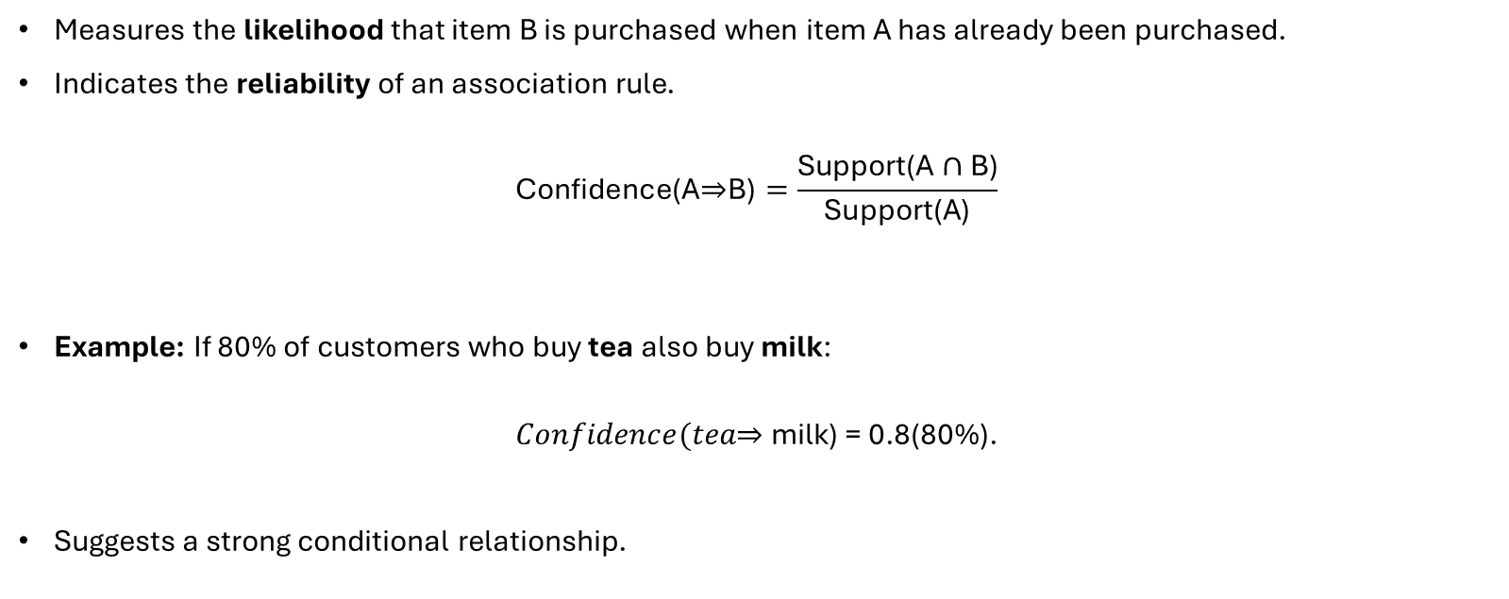
Metric 2: Confidence
Measures the likelihood that item B is purchased when item A has already been purchased.
Indicates the reliability of an association rule.
$$\text{Confidence}\text{(}\text{A}\text{⇒}\text{B}\text{)}=\frac{\text{Support}\text{(}\text{A}∩\text{B}\text{)}}{\text{Support}\text{(}\text{A}\text{)}}$$
Example: If 80% of customers who buy tea also buy milk:
$$Confidence(tea\text{⇒} \text{milk}\text{) = 0.8(80\%).}$$
Suggests a strong conditional relationship.

Slide 8

Metric 3: Lift
Quantifies the strength of an association by comparing co-occurrence with independent occurrence.
Lift > 1: Positive association (items bought together more than by chance).
Lift < 1: Negative association (items bought together less than by chance).
Lift = 1: No association (items bought together purely by chance).
$$\text{Lift}\text{(}\text{A} \text{⇒} \text{B}\text{)}=\frac{\text{Confidence}\text{(}\text{A} \text{⇒} \text{B}\text{)}}{\text{Support}\text{(}\text{B}\text{)}}$$
Notes:
Lift measures how much more likely two items are to occur together compared to if they were statistically independent. It tells you whether the association between items is genuine or just due to chance.
Lift answers the question: "Does knowing someone bought A actually help predict they'll buy B?"

Slide 9
Metric 3: Lift (cont.)
Example
Imagine a supermarket transaction dataset:
40% of customers buy bread → Support(bread) = 0.40
30% of customers buy butter → Support(butter) = 0.30
20% of customers buy both → Support(bread ∩ butter) = 0.20
Confidence(bread → butter) = 0.20 / 0.40 = 0.50
Lift(bread → butter) = 0.50 / 0.30 = 1.67
Since lift is 1.67 > 1, customers who buy bread are 67% more likely to also buy butter than a random customer — a meaningful association worth acting on (e.g., place them near each other).

Slide 10
Benefits of Association Rule Mining
Pattern Discovery: ARM uncovers hidden relationships between items that are not immediately obvious in large datasets. E.g. Market basket analysis (purchase of milk and bread)
Improved Decision-Making: It provides data-driven insights that help organizations make informed strategic and operational decisions. E.g. arrangements in supermarkets etc
Personalization: ARM enables recommendation systems that suggest relevant products or services based on user behavior. E.g. In e-commerce websites to drive user experience and profits.
Cross-Selling Opportunities: Businesses can bundle related products together to increase sales and revenue.
Operational Efficiency: Helps optimize inventory management and product placement by understanding demand patterns.
Scalability: ARM techniques can handle large volumes of transactional data efficiently.

Slide 11
Challenges of Association Rule Mining
Rule Explosion: ARM can generate too many rules, making it difficult to identify the most useful ones.
Computational Complexity: Processing large datasets with many item combinations can be time-consuming and resource-intensive.
Data Quality Issues: Poor or inconsistent data can lead to inaccurate or misleading association rules.
Spurious Relationships: Some discovered patterns may be coincidental rather than meaningful.
Threshold Selection: Choosing appropriate support and confidence values is challenging and affects results significantly.

Slide 12
Ethical and Practical Considerations
Data Privacy: ARM must ensure that sensitive personal data is protected and used in compliance with regulations.
Bias and Fairness: Biased data can lead to unfair or discriminatory patterns and decisions.
Transparency: The generated rules should be interpretable and understandable to stakeholders.
Data Security: Proper safeguards are required to prevent unauthorized access to datasets.
Responsible Use: Insights from ARM should be applied ethically, avoiding manipulation or exploitation of users.

Slide 13
Apriori Algorithm
Steps of Apriori Algorithm
Identifying Frequent Item-Sets starts by looking through all the data to count how many times each single item appears (1 Item-sets) Uses minimum support to filter the frequent item-set
Creating Possible Item Group After finding the single items that appear often enough (frequent 1-item groups) the algorithm combines them to create pairs of items (2-item groups). Then it checks which pairs are frequent by seeing if they appear enough times in the data
Removing Infrequent Item Groups If a group of items does not appear often enough then any larger group that includes these items will also not appear often. Because of this the algorithm does not check those larger groups. This way it avoids wasting time looking at groups that won’t be important make the whole process faster.
Generating Association Rules Rules are then made to show how items are related. The rules are checked using support, confidence and lift to find the strongest ones
One of the earliest and most popular methods for Association Rule Mining (ARM).
Follows a systematic process that involves the following key steps.

Slide 14

Apriori Algorithm
Support
Measures how frequently an item appears in the dataset relative to the total number of transactions. A higher support indicates a more significant presence of the Item-Set in the dataset.
$Support \left(A\right)= \frac{\# of transactions containing A}{\# of transactions}$
Confidence
Assesses the likelihood that an item B is purchased when item A is purchased. It provides insight into the strength of the association between two items.
$Confidence\left(A→B\right)=\frac{\# of transactions containing A and B}{\# of transactions containing A}$
Lift
evaluates how much more likely two items are to be purchased together compared to being purchased independently.
Shows the strength of a rule (how strong the connection is between items)
$Lift\left(A→B\right)=\frac{Confidence(A→B)}{Support(A)}$

Slide 15
Apriori Algorithm - Example
Transaction ID | Items Bought
1 | {Bread, Butter, Milk}
2 | {Bread, Butter}
3 | {Beer, Cookies, Diapers}
4 | {Milk, Diapers, Bread, Butter}
5 | {Beer, Diapers}
Apply Apriori algorithm to discover strong association rules among the items bought
Assume that minimum support = 40% and minimum confidence = 70%
Generate association rules from the frequent itemsets. Calculate the confidence of each rule and identify all the strong association rules.
Generate candidate itemsets and qualified frequent itemsets step by step until largest frequent itemset is generated.
$Minium suppport count=minimum support ×itemsets count=40\% ×5=2$
1 – Item Set | Support Count
Bread | 3
Butter | 3
Diapers | 3
Milk | 2
Beer | 2
Cookies | 1
1 – Frequent Item Set | Support Count
Bread | 3
Butter | 3
Diapers | 3
Milk | 2
Beer | 2
→

Slide 16
Apriori Algorithm - Example
Bread, Butter, Diapers, Milk, Beer
Bread, Butter, Milk
2 – Item Set | Support Count
Bread, Butter | 3
Bread, Diapers | 1
Bread, Milk | 2
Bread, Beer | 0
Butter, Diapers | 1
Butter, Milk | 2
Butter, Beer | 0
Diapers, Milk | 1
Diapers, Beer | 2
Milk, Beer | 0
2 – Frequent Item Set | Support Count
Bread, Butter | 3
Bread, Milk | 2
Butter, Milk | 2
Diapers, Beer | 2
→
→
3 – Frequent Item Set | Support Count
Bread, Butter, Milk | 2

Slide 17
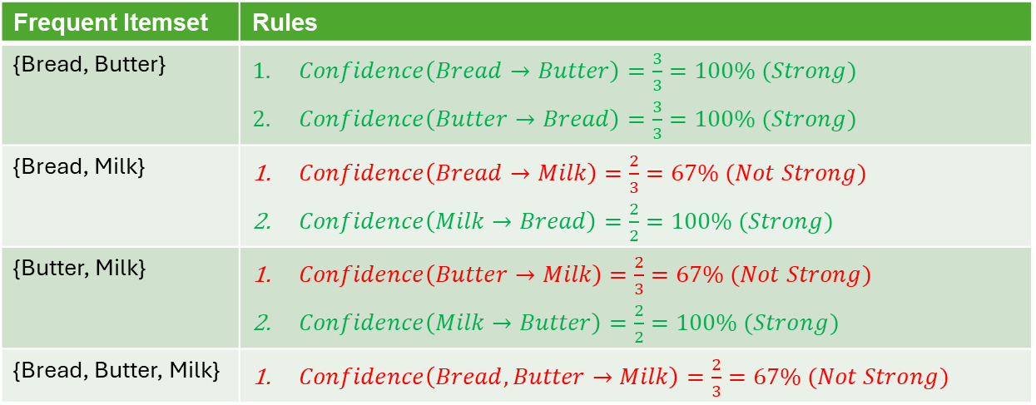
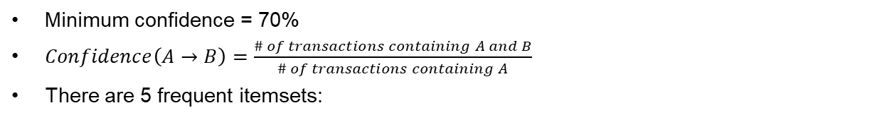
Apriori Algorithm - Example
1 – Frequent Item Set | Support Count
Bread | 3
Butter | 3
Diapers | 3
Milk | 2
Beer | 2
Minimum confidence = 70%
$Confidence\left(A→B\right)=\frac{\# of transactions containing A and B}{\# of transactions containing A}$
There are 5 frequent itemsets:
Frequent Itemset | Rules
{Bread, Butter} | $Confidence\left(Bread→Butter\right)=\frac{3}{3}=100\% (Strong)$ $Confidence\left(Butter→Bread\right)=\frac{3}{3}=100\% (Strong)$
{Bread, Milk} | $Confidence\left(Bread→Milk\right)=\frac{2}{3}=67\% (Not Strong)$ $Confidence\left(Milk→Bread\right)=\frac{2}{2}=100\% (Strong)$
{Butter, Milk} | $Confidence\left(Butter→Milk\right)=\frac{2}{3}=67\% (Not Strong)$ $Confidence\left(Milk→Butter\right)=\frac{2}{2}=100\% (Strong)$
{Bread, Butter, Milk} | $Confidence\left(Bread, Butter→Milk\right)=\frac{2}{3}=67\% (Not Strong)$
2 – Frequent Item Set | Support Count
Bread, Butter | 3
Bread, Milk | 2
Butter, Milk | 2
Diapers, Beer | 2
3 – Frequent Item Set | Support Count
Bread, Butter, Milk | 2

Slide 18
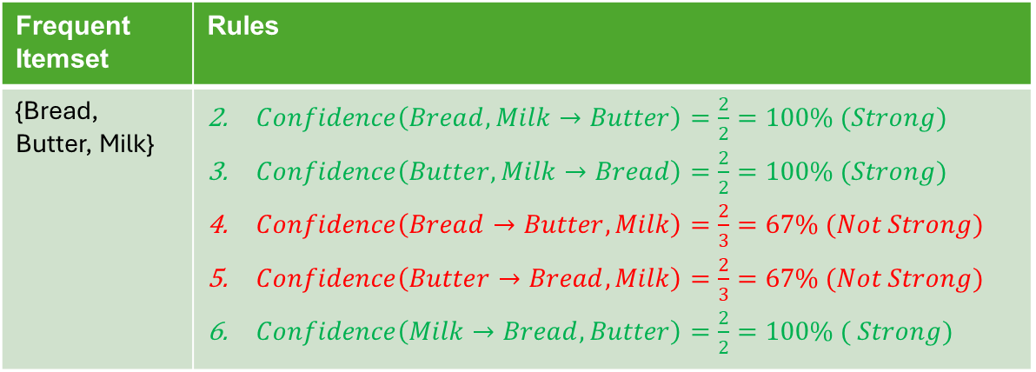
Apriori Algorithm - Example
Frequent Itemset | Rules
{Bread, Butter, Milk} | $Confidence\left(Bread, Milk→Butter\right)=\frac{2}{2}=100\% (Strong)$ $Confidence\left(Butter, Milk→Bread\right)=\frac{2}{2}=100\% (Strong)$ $Confidence\left(Bread→Butter, Milk\right)=\frac{2}{3}=67\% (Not Strong)$ $Confidence\left(Butter→Bread, Milk\right)=\frac{2}{3}=67\% (Not Strong)$ $Confidence\left(Milk→Bread, Butter\right)=\frac{2}{2}=100\% ( Strong)$

Slide 19
FP (Frequent Pattern) Growth Algorithm
Avoids the inefficiencies affecting Apriori by compressing the data into an FP-Tree (Frequent Pattern Tree) and extracts patterns directly from it.
Steps of FP (Frequent Pattern) Growth Algorithm
Data compression First FP-Growth compresses the dataset into a smaller structure called the Frequent Pattern Tree (FP-Tree). This tree stores information about item sets (collections of items) and their frequencies without need to generate candidate sets like Apriori does.
Mining the tree The algorithm then examines this tree to identify patterns that appear frequently based on a minimum support threshold. It does this by breaking the tree down into smaller "conditional" trees for each item making the process more efficient.
Generating patterns Once the tree is built and analyzed the algorithm generates the frequent patterns (itemsets) and the rules that describe relationships between items.

Slide 20
FP (Frequent Pattern) Growth Algorithm
Demonstrating the flow of the algorithm using the sample transactions below. Each letter represents an item in each transaction. The minimum support is 3.
Transaction ID | Items
T1 | {E,K,M,N,O,Y}
T2 | {D,E,K,N,O,Y}
T3 | {A,E,K,M}
T4 | {C,K,M,U,Y}
T5 | {C,E,I,K,O,O}
1. Getting the frequency of each individual item
→
Transaction ID | Items
A | 1
C | 2
D | 1
E | 4
I | 1
K | 5
M | 3
N | 2
O | 3
U | 1
Y | 3

Slide 21
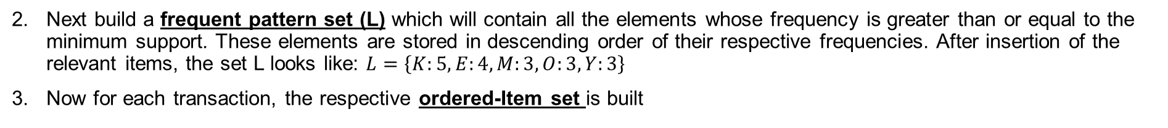
FP (Frequent Pattern) Growth Algorithm
Next build a frequent pattern set (L) which will contain all the elements whose frequency is greater than or equal to the minimum support. These elements are stored in descending order of their respective frequencies. After insertion of the relevant items, the set L looks like: $L=\left\{K:5,E:4,M:3,O:3,Y:3\right\}$
Now for each transaction, the respective ordered-Item set is built
Transaction ID | Items | Ordered Item Set
T1 | {E,K,M,N,O,Y} | {K,E,M,O,Y}
T2 | {D,E,K,N,O,Y} | {K,E,O,Y}
T3 | {A,E,K,M} | {K,E,M}
T4 | {C,K,M,U,Y} | {K,M,Y}
T5 | {C,E,I,K,O,O} | {K,E,O}
The ordered item sets are inserted into a tree data structure as shown in the next slide.

Slide 22
FP (Frequent Pattern) Growth Algorithm
Transaction ID | Items | Ordered Item Set
T1 | {E,K,M,N,O,Y} | {K,E,M,O,Y}
T2 | {D,E,K,N,O,Y} | {K,E,O,Y}
T3 | {A,E,K,M} | {K,E,M}
T4 | {C,K,M,U,Y} | {K,M,Y}
T5 | {C,E,I,K,O,O} | {K,E,O}
Inserting the set {K,E,M,O,Y}
NULL
K:1
E:1
M:1
O:1
Y:1

Slide 23
FP (Frequent Pattern) Growth Algorithm
Transaction ID | Items | Ordered Item Set
T1 | {E,K,M,N,O,Y} | {K,E,M,O,Y}
T2 | {D,E,K,N,O,Y} | {K,E,O,Y}
T3 | {A,E,K,M} | {K,E,M}
T4 | {C,K,M,U,Y} | {K,M,Y}
T5 | {C,E,I,K,O,O} | {K,E,O}
Inserting the set {K,E,O,Y}
NULL
K:2
E:2
M:1
O:1
O:1
Y:1
Y:1

Slide 24
FP (Frequent Pattern) Growth Algorithm
Transaction ID | Items | Ordered Item Set
T1 | {E,K,M,N,O,Y} | {K,E,M,O,Y}
T2 | {D,E,K,N,O,Y} | {K,E,O,Y}
T3 | {A,E,K,M} | {K,E,M}
T4 | {C,K,M,U,Y} | {K,M,Y}
T5 | {C,E,I,K,O,O} | {K,E,O}
Inserting the set {K,E,M}
NULL
K:3
E:3
M:2
O:1
O:1
Y:1
Y:1

Slide 25
FP (Frequent Pattern) Growth Algorithm
Transaction ID | Items | Ordered Item Set
T1 | {E,K,M,N,O,Y} | {K,E,M,O,Y}
T2 | {D,E,K,N,O,Y} | {K,E,O,Y}
T3 | {A,E,K,M} | {K,E,M}
T4 | {C,K,M,U,Y} | {K,M,Y}
T5 | {C,E,I,K,O,O} | {K,E,O}
Inserting the set {K,M,Y}
NULL
K:4
E:3
M:2
M:1
O:1
O:1
Y:1
Y:1
Y:1

Slide 26
FP (Frequent Pattern) Growth Algorithm
Transaction ID | Items | Ordered Item Set
T1 | {E,K,M,N,O,Y} | {K,E,M,O,Y}
T2 | {D,E,K,N,O,Y} | {K,E,O,Y}
T3 | {A,E,K,M} | {K,E,M}
T4 | {C,K,M,U,Y} | {K,M,Y}
T5 | {C,E,I,K,O,O} | {K,E,O}
Inserting the set {K,E,O}
NULL
K:5
E:4
M:2
M:1
O:1
O:2
Y:1
Y:1
Y:1

Slide 27
FP (Frequent Pattern) Growth Algorithm
For each item, the Conditional Pattern Base is computed which is path labels for all the paths which lead to any node of the given item in the frequent-pattern tree.
Items | Conditional Pattern Base
Y | {{K,E,M,O : 1}, {K,E,O : 1}, {K,M : 1}}
O | {{K,E,M : 1}, {K,E : 2}}
M | {{K,E : 2}, {K : 1}}
E | {K : 4}
K
NULL
K:5
E:4
M:2
M:1
O:1
O:2
Y:1
Y:1
Y:1

Slide 28
FP (Frequent Pattern) Growth Algorithm
For each item the Conditional Frequent Pattern Tree is built. This is done by taking the set of elements which is common in all the paths in the conditional pattern base of that item and calculating it’s support count by summing the support counts of all the paths in the Conditional Pattern Base.
Items | Conditional Pattern Base | Conditional Frequent Pattern Tree
Y | {{K,E,M,O : 1}, {K,E,O : 1}, {K,M : 1}} | {K : 3}
O | {{K,E,M : 1}, {K,E : 2}} | {K,E : 3}
M | {{K,E : 2}, {K : 1}} | {K : 3}
E | {K : 4} | {K : 4}
K
From the Conditional Frequent Pattern Tree, the Frequent Pattern Rules are generated by pairing the items of the Conditional Frequent Pattern Tree set to the corresponding item as shown the in the table in the next slide

Slide 29
FP (Frequent Pattern) Growth Algorithm
From the Conditional Frequent Pattern Tree, the Frequent Pattern Rules are generated by pairing the items of the Conditional Frequent Pattern Tree set to the corresponding item as shown the in the table in the next slide.
Items | Conditional Pattern Base | Conditional Frequent Pattern Tree
Y | {{K,E,M,O : 1}, {K,E,O : 1}, {K,M : 1}} | {K : 3}
O | {{K,E,M : 1}, {K,E : 2}} | {K,E : 3}
M | {{K,E : 2}, {K : 1}} | {K : 3}
E | {K : 4} | {K : 4}
K
Items | Frequent Pattern Generated
Y | {<K,Y : 3>}
O | {<K,O : 3>, <E,O : 3>, <E,K,O : 3>}
M | {<K,M : 3>}
E | {<E,K : 3>}
K

Slide 30
ECLAT Algorithm
Equivalence Class Transformation (ECLAT)
Efficient Association Rule Mining algorithm
Uses vertical data format instead of horizontal scanning

Slide 31
How ECLAT Works
Starts with a Horizontal Data Format
Set Minimum Support Count
Convert dataset to vertical format (items → transaction IDs)
Find frequent itemsets by intersecting TID-lists
Repeat intersections to generate larger itemsets
Intersection: Generate new candidate 2-itemsets by intersecting the TID lists of two frequent 1-itemsets. If the resulting intersection meets the minimum support, it is a frequent 2-itemset.
Pruning & Repetition: The process continues recursively (depth-first). Larger k-itemsets are generated by intersecting the TID lists of frequent (k-1)-itemsets, and any itemset that falls below the minimum support threshold is pruned immediately.
Termination: The algorithm stops when no more frequent itemsets can be found (i.e., no intersections meet the minimum support threshold).

Slide 32
Example - Starts with a Horizontal Data Format
Transaction | Items
1 | Ugali, Fish, Managu
2 | Chapati, Fish, Tea, Juice
3 | Ugali, Chapati, Fish, Tea
4 | Chapati, Tea
5 | Ugali, Fish, Tea

Slide 33
Example - Convert to Vertical Data Format
Items | Transaction
Ugali | 1, 3, 5
Chapati | 2, 3, 4
Fish | 1, 2, 3, 5
Managu | 1
Tea | 2, 3, 4, 5
Juice | 2

Slide 34
Example - Generate Frequent 1-Itemsets Based on Support Count
For our example, we set MinSup = 3
Items | Transaction | Support Count
Ugali | 1, 3, 5 | 3
Chapati | 2, 3, 4 | 3
Fish | 1, 2, 3, 5 | 4
Managu | 1 | 1
Tea | 2, 3, 4, 5 | 4
Juice | 2 | 1
Items | Transaction | Support Count
Ugali | 1, 3, 5 | 3
Chapati | 2, 3, 4 | 3
Fish | 1, 2, 3, 5 | 4
Tea | 2, 3, 4, 5 | 4

Slide 35
Example - Repeat intersections to generate larger itemsets
Items | Transaction | Support Count
Ugali, Chapati | 3 | 1
Ugali, Fish | 1, 3, 5 | 3
Ugali, Tea | 3, 5 | 2
Chapati, Fish | 2, 3 | 2
Chapati, Tea | 2, 3, 4 | 3
Fish, Tea | 2, 3, 5 | 3
Items | Transaction | Support Count
Ugali, Chapati, Fish | 3 | 1
Ugali, Chapati, Tea | 3 | 1
Ugali, Fish, Tea | 3, 5 | 2
Chapati, Fish, Tea | 2, 3 | 2
STOP HERE

Slide 36
Example - Frequent Itemsets
Items | Transaction | Support Count
Ugali | 1, 3, 5 | 3
Chapati | 2, 3, 4 | 3
Fish | 1, 2, 3, 5 | 4
Tea | 2, 3, 4, 5 | 4
Ugali, Fish | 1, 3, 5 | 3
Chapati, Tea | 2, 3, 4 | 3
Fish, Tea | 2, 3, 5 | 3
All itemsets that meet MinSup = 3

Slide 37
Example - Association Rules and Confidence
Items | Transaction | Support Count | Association Rule | Confidence
Ugali | 1, 3, 5 | 3 | N/A | N/A
Chapati | 2, 3, 4 | 3 | N/A | N/A
Fish | 1, 2, 3, 5 | 4 | N/A | N/A
Tea | 2, 3, 4, 5 | 4 | N/A | N/A
Ugali, Fish | 1, 3, 5 | 3 | Ugali -> Fish | 3/3 -> 100%
 |  |  | Fish -> Ugali | ¾ -> 75%
Chapati, Tea | 2, 3, 4 | 3 | Chapati -> Tea | 3/3 -> 100%
 |  |  | Tea -> Chapati | ¾ -> 75%
Fish, Tea | 2, 3, 5 | 3 | Fish -> Tea | ¾ -> 75%
 |  |  | Tea -> Fish | ¾ -> 75%

Slide 38
Finally – Power of the Association Rules
Item Ordered | Recommended With | Confidence
Ugali | Fish | 100%
Fish | Ugali | 75%
Chapati | Tea | 100%
Tea | Chapati | 75%
Fish | Tea | 75%
Tea | Fish | 75%

Slide 39
Applications in Kenya
Market basket analysis in supermarkets
In retail to identify items frequently purchased together
Customer behavior modelling
Analyze customer past purchase patterns to suggest products
Supply chain optimization in retail and agriculture
Identifying patterns in regional produce orders to optimize truckload assignments and routing, reducing transportation time for perishable goods.
Medical Diagnosis
Analyzing co-occurring symptoms, treatments, or diseases within patient medical records to discover patterns and improve diagnosis.
Fraud Detection
Identifying frequent patterns within large transactional datasets that indicate fraudulent activity e.g. Mpesa

Slide 40
Choosing the Right Algorithm
Data Size & Density:
ECLAT & FP-Growth → large/dense datasets
Apriori → small datasets
Memory:
ECLAT → high (TID lists)
FP-Growth → compact
Ease:
Apriori easiest
ECLAT & FP-Growth faster but complex

Slide 41
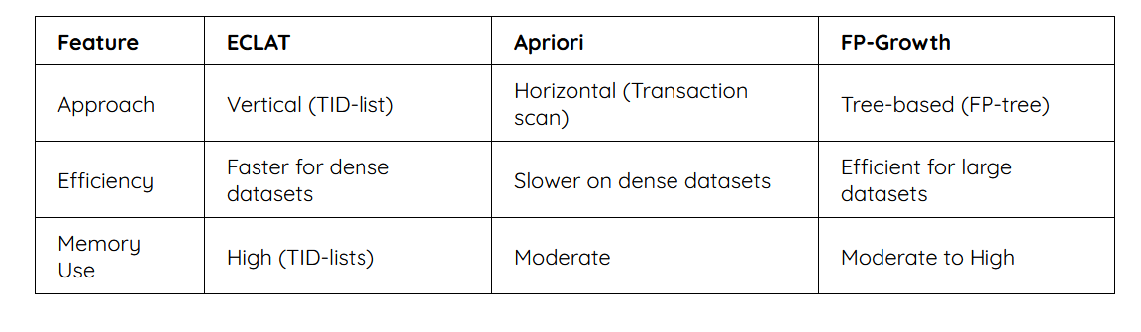
Algorithm Comparison

Slide 42
Challenges of ARM in Big Data
1 of 2
High Computational Complexity
01
Mining frequent itemsets requires exponential search space (2ᵐ for m items). A retail dataset with 10,000 unique products generates over 50 million possible itemsets.
Memory & Storage Limitations
02
Traditional algorithms need to store intermediate candidate sets in memory. A social media platform analyzing 1 billion posts cannot hold all candidate pairs in RAM.
Data Sparsity & High Dimensionality
03
Many big datasets are sparse but have extremely high item dimensions. In web clickstream data, meaningful long-tail patterns become very hard to capture.

Slide 43
Challenges of ARM in Big Data
2 of 2
Distributed Processing Overheads
04
Parallelizing ARM introduces synchronization, shuffling, and load-balancing overheads. Running Apriori on a 100-node Spark cluster for genomic data can cause network bottlenecks.
Handling Data Velocity (Streaming)
05
Big data often arrives in real-time. Batch ARM cannot update rules incrementally. In network intrusion detection, rules must adapt within seconds to new attack patterns.
Interpreting & Validating Numerous Rules
06
Big data produces millions of rules, many being redundant, trivial, or spurious. Mining hospital records may yield uninteresting rules; separating actionable rules from noise is a major challenge.

Slide 44
Tools & Frameworks for ARM
in Big Data
Apache Spark
(MLlib)
PAMI
(Python)
KNIME +
Spark Ext.
FP-Growth, Parallel PFP, scales to billions of transactions
Parallel Apriori, ECLAT, FP-Growth with multi-core processing
Visual drag-and-drop distributed FP-Growth, no coding required
R: arules &
niarules
Apache
Mahout
Hadoop
MapReduce
Classic binary/categorical data; nature-inspired for numerical data
Hadoop-based Parallel FP-Growth for large cluster deployments
Parallel Apriori across nodes; best for multi-terabyte batch jobs

Slide 45
Practical Applications of ARM in Big Data
Retail & E-Commerce
Healthcare
Web & User Behavior
Market Basket Analysis
Clinical Informatics
Clickstream Analysis
Amazon/Walmart analyze millions of orders to find co-purchase patterns, driving cross-selling and smarter inventory placement.
Mining EHRs reveals symptom-diagnosis or drug-reaction patterns, enabling early alerts for physicians on patient risk.
News sites analyze billions of clicks to identify navigation patterns and optimize real-time ad targeting.
Telecom & Security
Agriculture
Fraud Detection
Crop & Yield Optimization
Mobile carriers detect SIM box fraud by mining call data patterns — e.g., short international calls from new SIMs.
ARM suggests best fertilizer combinations by uncovering relationships between weather, yields, and farming practices from cooperative data.

Slide 46
Emerging Trends in
Association Rule Mining

Slide 47
Emerging Trends at a Glance
01
02
03
Deep Learning Integration
Explainable AI (XAI)
Real-Time Mining
LSTM hybrids, neural embeddings, GANs
Semantic pruning, post-hoc explanations
Streaming, sliding windows, M-Pesa fraud
04
05
06
Privacy-Preserving ARM
High-Utility Mining
Context-Aware & Ethical ARM
Differential privacy, homomorphic encryption
Profit-driven rules, rare pattern detection
Time, location, bias mitigation

Slide 48
Deep Learning Integration
Neuro-associative mining: augmenting classical algorithms with neural architectures
ARM-LSTM hybrids
Long Short-Term Memory networks add a temporal dimension to ARM. Businesses see not just what is bought together, but when and in what sequence, significantly improving demand forecasting.
Neural embeddings for items
Items are represented as dense vectors in semantic space, capturing similarity that frequency counts alone miss. This improves recommendation systems and NLP-based rule discovery.
GANs for pattern discovery
Generative Adversarial Networks simulate transaction data to stress-test rules and uncover complex non-linear patterns that traditional frequent itemset mining would miss.
Example: detecting rare fraud combinations in simulated banking transaction datasets
Trend 01 of 06

Slide 49
Explainable AI (XAI) and Rule Interpretability
Making ARM results understandable, auditable, and actionable for decision-makers
Semantic pruning using NLP
Natural Language Processing filters out obvious or redundant rules automatically. Systems surface genuinely novel insights rather than stating that people who buy a phone also buy a screen protector.
Post-hoc explanations for black-box models
ARM mines associations between a model's inputs and its high-confidence predictions, creating a human-readable map of why the AI made a particular decision. Frameworks like LORE and ANCHOR use this approach.
Visual analytics for ARM results
Advanced visualization techniques make ARM outputs more interpretable for non-technical decision-makers, enabling faster and more confident action on discovered patterns.
Key use case: regulatory compliance, audit trails, and transparent AI governance
Trend 02 of 06

Slide 50
Real-Time and Incremental Mining
Moving ARM from batch processing into live streaming environments
Incremental ARM algorithms
New algorithms (IncA, updated Eclat) update rule sets without re-scanning the entire historical database. Only the delta of new data is processed, making rule updates feasible in near-real-time.
Sliding window analysis
Techniques focus on the most recent N transactions, allowing retailers and platforms to spot flash trends lasting only a few hours. Apache Kafka and Spark Streaming handle the underlying data streams.
Fraud detection in mobile money
Real-time ARM analyzes patterns such as unusually high-frequency transfers or odd transaction timings, flagging suspicious activity before financial loss occurs.
Kenya example: real-time fraud pattern detection in M-Pesa mobile money transactions
Trend 03 of 06

Slide 51
Privacy-Preserving ARM (PPARM)
Mining sensitive data responsibly under GDPR, CCPA, and Kenya's Data Protection Act 2019
Differential privacy
Controlled noise is injected into datasets so individual transactions cannot be identified, while the global association rules remain statistically accurate. Individual privacy holds; pattern discovery continues.
Homomorphic encryption
ARM algorithms run on encrypted data without ever seeing the raw information, enabling secure collaboration, such as two banks jointly mining for cross-institutional fraud patterns.
Federated learning approaches
Rules are mined locally on separate data silos and only aggregated rule summaries are shared. Critical in healthcare and finance where raw data cannot legally leave its source institution.
Regulatory context: Kenya Data Protection Act 2019 requires organizations to protect individual data while still deriving analytical value
Trend 04 of 06

Slide 52
High-Utility and Multi-Objective Mining
Shifting the question from 'what is most frequent?' to 'what is most valuable?'
High-Utility Itemset Mining (HUIM)
Profit, weight, or risk values are assigned to items. Even an infrequent rule is prioritized if it leads to high-margin sales or critical outcomes. Algorithms like HUI-Miner and FHM replace pure support-confidence frameworks.
Rare pattern mining (black swan events)
Identifies patterns that occur very rarely but carry a massive impact, such as specific hardware failure combinations in infrastructure or early-stage indicators of rare diseases in clinical data.
Agricultural and supply chain applications
Machine learning-integrated ARM analyzes farmer input patterns and recommends optimal planting strategies based on historical data and environmental factors.
Kenya example: smallholder farmer input optimization using historical planting and yield data
Trend 05 of 06

Slide 53
Context-Aware and Ethical ARM
Rules sensitive to time, location, user preferences, and fairness considerations
Context-aware rule generation
Rules incorporate contextual factors such as time of day, location, and user preferences rather than treating all transactions as identical, making recommendations significantly more relevant and actionable.
Ethics and bias mitigation
Bias in rule generation can lead to unfair or harmful outcomes, particularly in healthcare and credit scoring. Responsible ARM requires auditing rules for discriminatory patterns and ensuring transparency in decision-making.
Healthcare and data compliance
ARM in clinical settings must adhere to data protection regulations while delivering genuine patient outcome improvements. Ethical frameworks govern what associations can be acted upon and by whom.
Nairobi example: a supermarket promoting breakfast items in the morning and snacks in the evening based on time-of-day context
Trend 06 of 06

Slide 54
Traditional vs. Emerging ARM
Dimension | Traditional ARM (Apriori / FP-Growth) | Emerging ARM (2024-2026)
Primary metric | Support and confidence | Utility, profit, and time-lag
Data type | Static, categorical | Streaming, sequence-based, graph
Computation | Batch processing (slow) | Incremental and parallel (real-time)
Output | Thousands of raw rules | Pruned, interpretable insights
Privacy | Not considered | Differential privacy, federated learning
Learning approach | Rule-based only | Hybrid with deep learning
Context sensitivity | Context-blind | Time, location, user-aware

Slide 55
Key Takeaway
ARM is evolving from
frequency to value.
From static batch rules to real-time, privacy-aware, utility-driven,
and contextually intelligent pattern discovery.

